Slide 1

Department of Computer Engineering
External Audit - 2024-25 & 2025-26
02nd Oct, 2026

Slide 2
About Department- NR

Slide 3
Faculty list (2025-26) NR
SN. | Name | SN. | Name
1. | Dr. Sudhir Dhage | 8. | Dr. Prasenjit Bhavathankar
2. | Dr. Surekha Dholay | 9. | Prof. Anand Godbole
3. | Dr. Anant Nimkar | 10. | Prof. Reeta Koshy
4. | Dr. Nataasha Raul | 11. | Prof. Sunil Ghane
5. | Dr. Pramod Bide | 12. | Prof. Abhijeet Salunke
6. | Dr. Kailas Devadkar | 13. | Prof. Jyoti Ramteke
7. | Dr. Disha Sail | 14. | Prof. Swapnali Kurhade

Slide 4
Vision - Mission of the Institute - Rupali S.
Vision
“To be a leading technical institution constantly pursuing excellence to develop holistic contributors for the society.”
Mission
To provide a conducive academic and research environment that stimulates learning, promotes intellectual growth, and ensures professional development of students, faculty, and staff.
To collaborate with renowned industry, academic institutions, and research laboratories for academics and research to solve real life problems.
To leverage the strength of alumni to foster industry-relevant coaching and mentoring of the students.
To nurture values with a sense of social responsibility and inculcate attitude and skills required for holistic development of the students.

Slide 5
Vision - Mission Computer Engineering Department- Rupali S.
Vision
“To impart the education that graduates globally competent, socially sensitive, contributory computer professionals.”
Mission
To provide rigorous, conducive academic environment and constantly innovate in the design of the curriculum and its deployment (T-L-E-A Processes).
To collaborate with industries and academia to strengthen education and ensure relevant research.
To focus on experiential learning and inculcate problem solving, leadership, professional ethics, teamwork and sensitivity to the real-world problems.
To ensure a professional growth mindset that translates to lifelong learning for all.

Slide 6
CRITERIA A -
CURRICULUM DESIGN 2024-25 & 2025-26
AVS

Slide 7
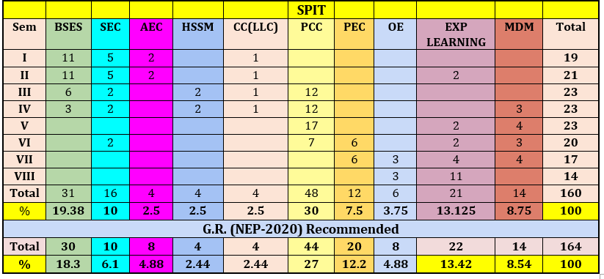
A.1. The curriculum is well thought and makes sincere attempt to follow the National Guidelines in terms of number of credits of the program, balance of credits for Mathematics, Science, Engineering Science, Program Core, Program Electives and Humanities and Social science related courses.

Slide 8
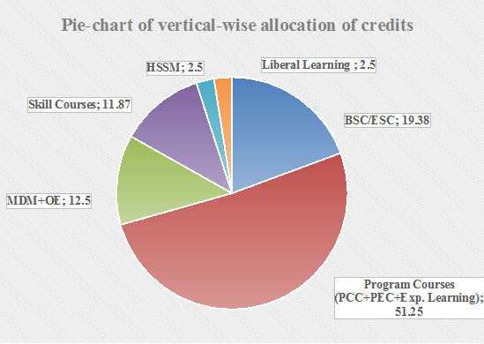
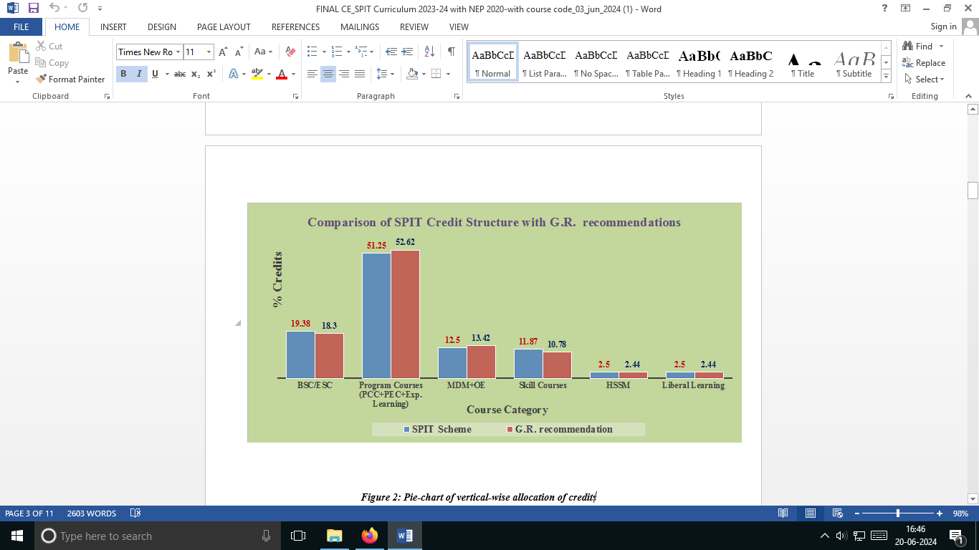
Credit Distribution
*The curriculum is well thought and makes sincere attempt to follow the National Guidelines in terms of number of credits of the program, balance of credits for Mathematics, Science, Engineering Science, Program Core, Program Electives and Humanities and Social science related courses.

Slide 9
Link to Curriculum Scheme
Scheme
comp-scheme-2024.pdf
Syllabus
Computer Engineering Syllabus SPIT NEP 2023-2027_v15_Website.docx

Slide 10
A.2. Enough flexibility is incorporated in the curriculum to enable students to take courses of their choice wherever possible. Some sincere efforts towards CBCS are observed.
Flexibility of choice is provided through courses such as,
Program Elective
Open Elective
Multidisciplinary Minor
Liberal Learning
Humanities and Social Science
Students can select electives as per their interests.

Slide 11
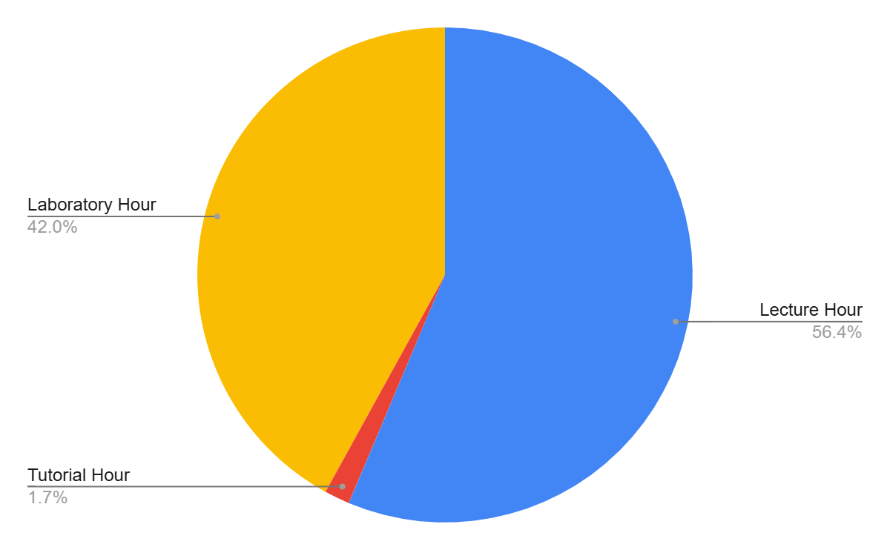
A.3. Curriculum has a balance of theory and laboratory sessions, to ensure strong hands-on learning.
L | Lecture Hour | 102
T | Tutorial Hour | 3
L | Laboratory Hour | 76
O | Other Work (Self Study) | 231
T | Total Engagement in Hours | 410
C | Credit Assigned | 160

Slide 12
A.4. The curriculum encourages the learning from the MOOCs/NPTEL
MOOC and NPTEL courses are introduced as a part of Program Electives and HSSE courses.
MOOC courses are selected considering the requirements from the industry and in track with Syllabus

Slide 13
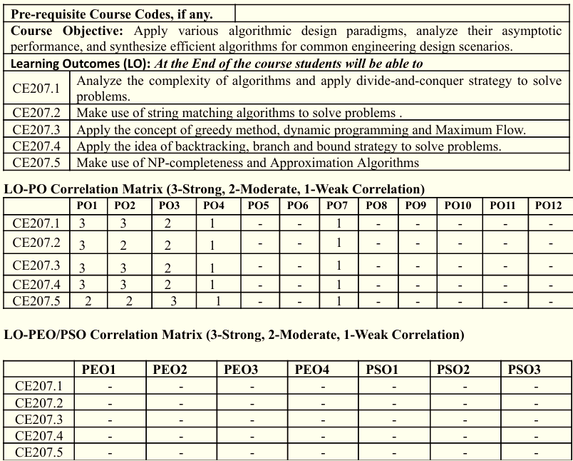
A.5. Curriculum justifies the Program Outcomes and PSOs articulated
Each course syllabus individually maps its course outcomes with PO and PSO.

Slide 14
A.6. Curriculum is well thought, innovative, suits the outcome-based education and has sufficient bandwidth as well as depth of domain.
The curriculum satisfy all the requirements of NEP.
It is designed on the basis of outcome based education framework.
It includes novel ideas such as research internship, MDM, Industry internship and research with honours.

Slide 15
B TEACHING-LEARNING PROCESS
This includes various process such as
Process to improve instruction methods
Process for collaborative learning
Process for improving quality of laboratory experience
Process for encouraging bright students
Process for assisting weak students
Initiatives to improve quality of internal assessment
Process to improve quality of Mid/End Semester Question Papers
Process to improve quality of assignments
Process to improve the evaluation

Slide 16
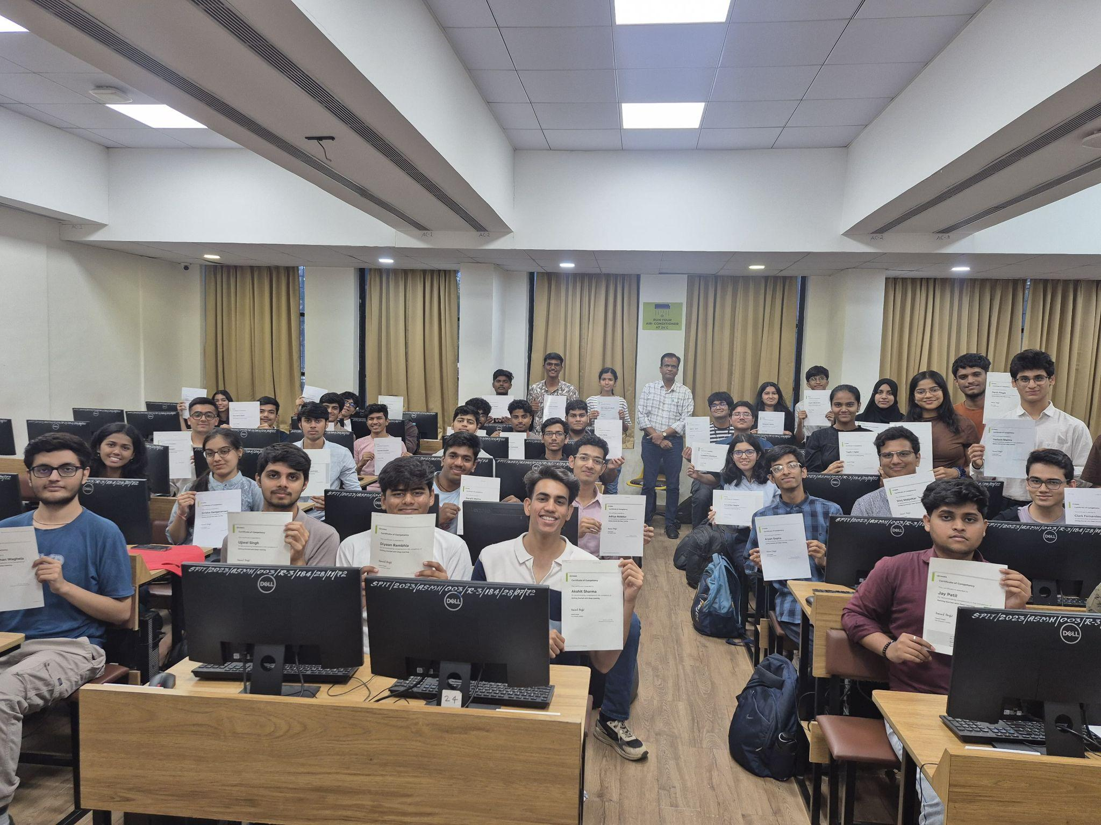
B.1. Department makes sincere attempts to collaborate for the design and delivery of the teaching and learning processes of the program, tries to follow best practices of higher institutions, and optimizes available resources, in pursuit of the excellence. GG
Students are provided digital content for the subjects on moodle LMS.
Evaluation of students is done using elaborate rubrics that are used in the laboratory for a thorough evaluation..
Industry provided skill enhancement programs for students from NVIDIA DLI for AI/ML domain.
Cross domain Skill enhancement programs for students during summer break under the aegis of ‘Beyond the Degree’.
MoU with Linux Professional Institute , Canada to provide curriculum for Cloud, Linux administration, DevOps and also preparing students for industry certifications.
24hr. hackathon like AIRAVAT is organised for the students.
Events like Quantum Computing Conclave for sunrise sectors like Quantum Computing for students and faculty alike.
FDP’s covering latest technologies like GENLANG 5.0 gave the faculty a new avenue to explore and learn.
Faculty of CE department are encouraged to participate in cross domain STTP like the one on NI LABVIEW delivered by industry partner NI-Emerson.
Cohort of NVIDIA DL program

Slide 17
B.2.Coursework (assignments, quizzes, lesson plan for various courses, laboratory expts etc) offer sufficient breadth and depth appropriate for the degree offered.
Lesson plans are meticulously designed and mapped to Course Outcomes (COs) to ensure comprehensive topic coverage.
Integration of real-world case studies to assess practical understanding and application.
Assignments and quizzes are calibrated across various Bloom’s Taxonomy levels to test higher-order thinking.
Extensive use of Project-Based Learning (PBL) to bridge theoretical concepts with hands-on development.

Slide 18
B.3. Department looks forward for Industry / alumni participation wherever possible, which is demonstrated by few examples of co-teaching, joint project work JR

Slide 19
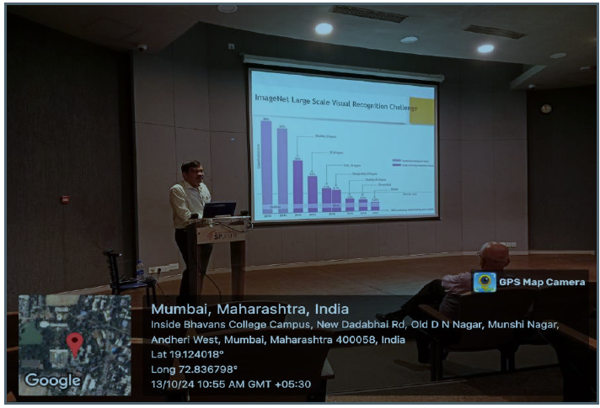
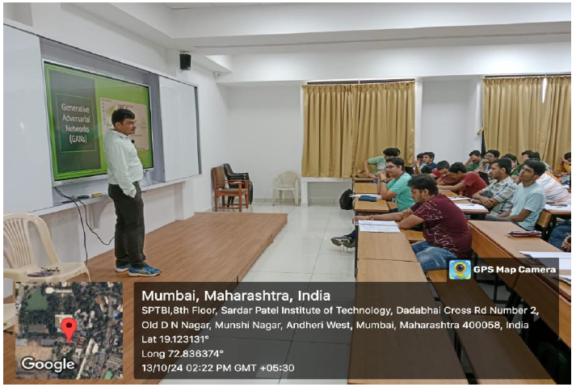
B.3. Department looks forward for Industry / alumni participation wherever possible, which is demonstrated by few examples of co-teaching, joint project work JR
Co teaching for Subject AIML, arranged by Prof. Swapnali Kurhade
Delivered by Dr. Maheshkumar H. Kolekar, IIT Patna on 13/10/2024

Slide 20
B.4. Project work is relevant, demonstrates the value addition and is of expected quality from bright undergraduate students. SBG
Relevance: Projects address real-world problems and have clear objectives.
Technical Skills: Students apply appropriate technologies and concepts to develop and test the solution.
Innovation & Value Addition: Projects show new ideas, practical solutions, and meaningful value addition.
Research & Publication: Students are encouraged to publish research papers or file patents based on their completed project work.

Slide 21
B.5. Department continuously upgrades laboratory infrastructure and year on year investment in the laboratory is sufficient. PJB
New Desktop Computers = 40Nos having latest configuration as mentioned bellow are purchased & installed
in “Database Lab (Lab-5)” and “Data Analytics Lab (Lab-6)” :-
HP Desktop Computer (Total Cost = 23,12,800/-Rs )
HPPRODESK 2 GLA
Desktop-D2YL7AT
R5
16 GB RAM
512 GB SSD,
HP 21.5" LED Monitor
New Desktop Computers = 40Nos having latest configuration as mentioned bellow are purchased & installed
in “Distributed Computing Lab (Lab-4)” and “System Programming Lab (Lab-8)” :-
HP Desktop Computer (Total Cost = 26,31,588/-Rs)
HPPRODESK 2Gla
Desktop-D2YL7AT
Core I5
16 GB RAM
512 GB SSD,
HP 21.5" LED Monitor

Slide 22
B.6. Support for slow and physically /socially /financially challenged students, and it is demonstrated by the sufficient evidence. AT
Faculty Name | Subject | Semester | Type | Count of Hours
Swapnali Kurhade | Operating Systems | 4 | Remedial Assignment | 3
Jyoti Ramteke | Artificial Intelligence and Soft Computing | 5 | Remedial Assignment | 3

Slide 23
B. 7.Department takes cautious efforts to challenge the bright students and provides them enough opportunities to demonstrate distinctive performance. AT
Disk scheduling simulator for fast learners:
Algorithm/ Logic Implementation: 8 – 12 hours
Canvas & Animation Engine : 12-15 hours
UI Design: 10-15 hours
Integration & Results Tracking : 6-10 hours
Testing, Debugging : 5-8 hours
Deployment & Documentation : 3-5 hours
Total time = ~54 hours

Slide 24
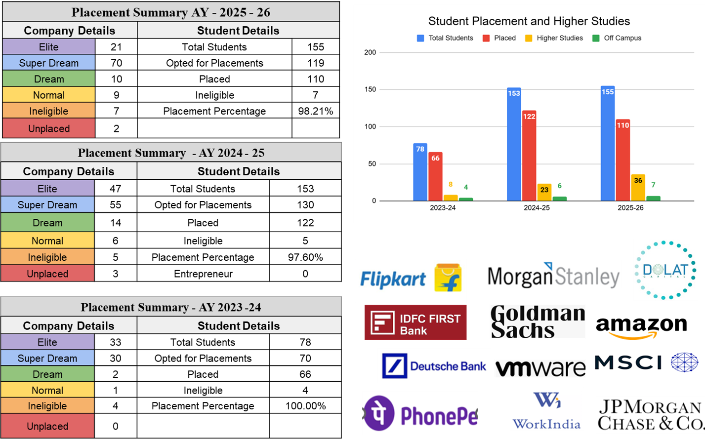
B.8.Student competency in terms of placements/ success in competitive examinations / selection for higher studies in reputed Universities/ institutes? Swapnali K

Slide 25
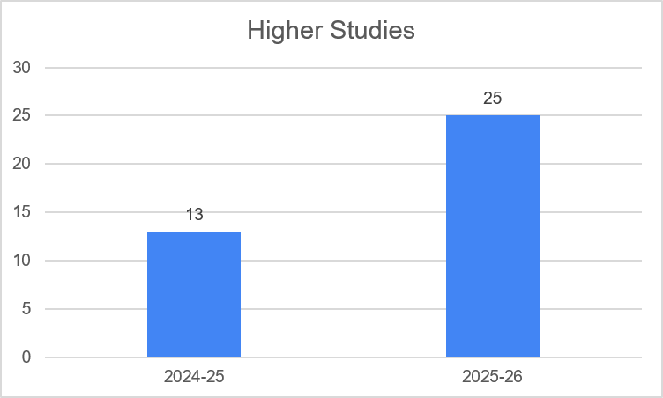
Higher Studies 2024-25 and 2025-26
AY | Count
2024-25 | 13
2025-26 | 25

Slide 26
C. Assessment and Evaluation

Slide 27
C.1 Quality of assignments/ test papers/ End Semester Examination papers appears to suit the quality of the students getting admitted
Question Paper is set as per the blooms taxonomy.
While setting the question papers , care is taken ,to ensure that all COs are covered including the self study topic.
For ESE paper 2 sets are drawn for every subject.
Difficulty Level of the Question Paper is set so as to ensure Gaussian curve.
Question paper moderation is done by internal faculty other than paper setter. Depending upon the suggestions received concerned faculty update the paper and then it is submitted to examination section.
Question Paper Audit was carried out by external faculty.

Slide 28
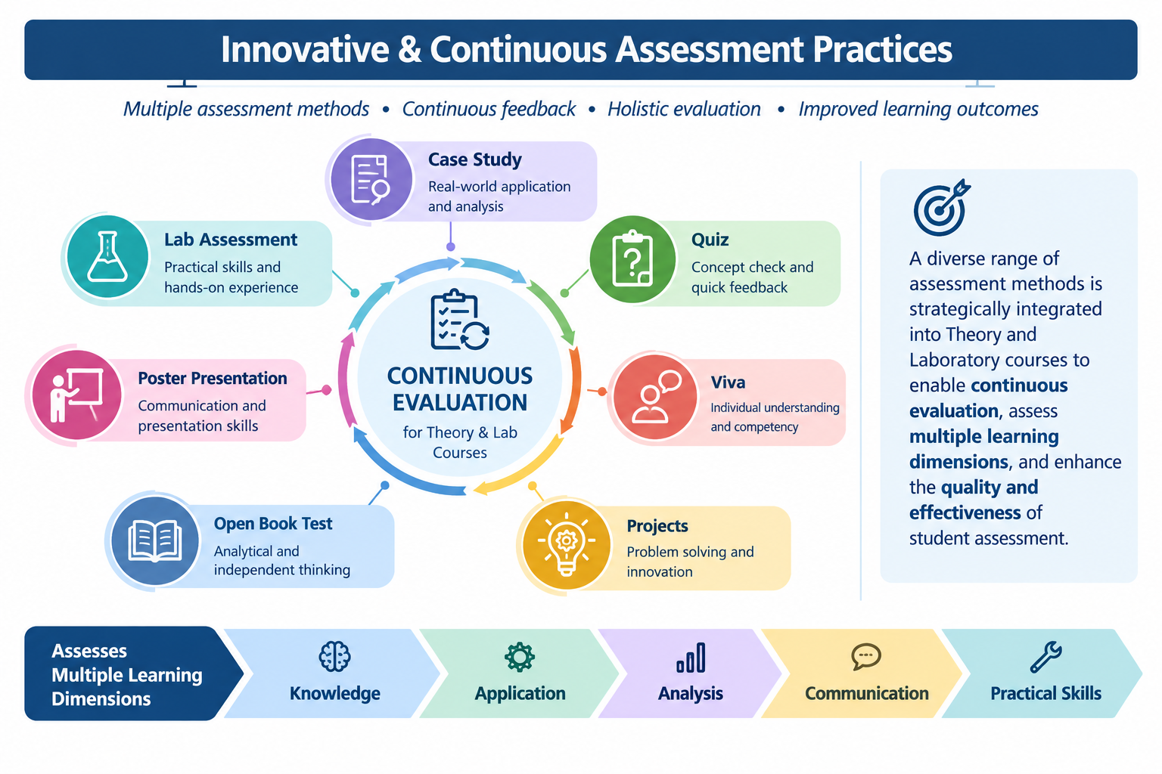
C2.Design and conduct of continuous assessment of theory and lab assignments is deeply thought of YP
Various assessments methods such as Case Study, Quiz ,Viva, Projects, Open Book Test ,Poster Presentation ,e.t.c. are designed for continuous evaluation for Theory and Lab courses to improve the quality of assessment
Link to Lesson Plan: https://drive.google.com/drive/folders/1kN8Dc457fqZv0e_R12Hv2X38NuQKinjM

Slide 29
C3.Wherever possible industry persons, alumni, external experts are invited for evaluation and assessment. SBG
Industry professionals, alumni, and external experts are invited, wherever possible, to evaluate projects, internships, and seminars and provide students with practical feedback and guidance.

Slide 30
C4 Coverage of syllabus in examinations including ISE, MSE, ESE is fair, and MSE/ESE are designed to have natural gaussian. - Rupali S. DAPC MOM-refer last audit ppt
DAPC MOM-EVEN SEM-Academic year 2025-2026
https://drive.google.com/file/d/1MdtJo7aheywK3D2SoT0fnc8Ii4I87VWW/view?usp=sharing
DAPC MOM ODD SEM Academic year 2025-26

Slide 31
C4. Coverage of syllabus in examinations including ISE, MSE, ESE is fair, and MSE/ESE are designed to have natural gaussian. June 2025 AAG -refer last audit ppt
Faculty Completes the syllabus by conducting extra lectures required if any also conducts remedial lectures if any.
Weightage for ISE - 20% , MSE is 20% and ESE is 100%.
upto MSE syllabus coverage is upto 40 to 50% and for ESE it is 100%.
After 2-3 weeks DAPC meeting gets conducted in which lesson plan is gets approved
Link for SA values
PG even sem 2025 26 :: https://drive.google.com/file/d/1yVCzptUAHAB7JG8ioJmkKxuVKWI0NTdE/view?usp=sharing
PG Odd sem 2025 26 :
https://drive.google.com/file/d/1cNbKmAUTvDkBCqct1wrzvA9VYpSagI2R/view?usp=sharing

Slide 32
C4. Coverage of syllabus in examinations including ISE, MSE, ESE is fair, and MSE/ESE are designed to have natural gaussian. June 2025 AAG -refer last audit ppt
UG even sem 2025 26: https://drive.google.com/file/d/16oR8o46WwVx6lkaNGlzVifPnFHaKH3BL/view?usp=sharing
UG odd sem 2025 26:
https://drive.google.com/file/d/1Av_rjzyfGylu5oWv0gCjZ9CCPu55sf73/view?usp=sharing

Slide 33
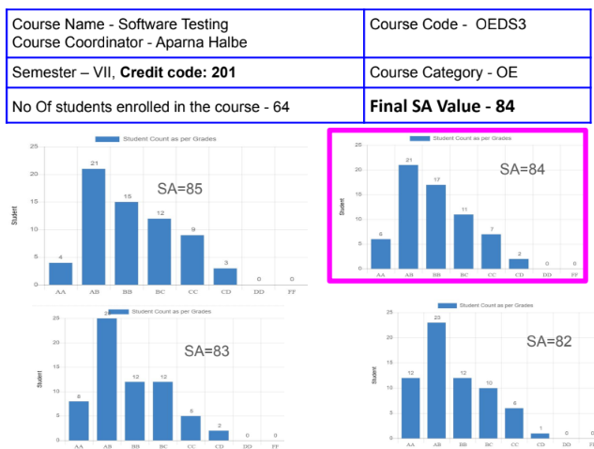
C4. Coverage of syllabus in examinations including ISE, MSE, ESE is fair, and MSE/ESE are designed to have natural gaussian. (OE)- AAG
SAMPLE Gaussian Distribution Graph for OE subjects

Slide 34
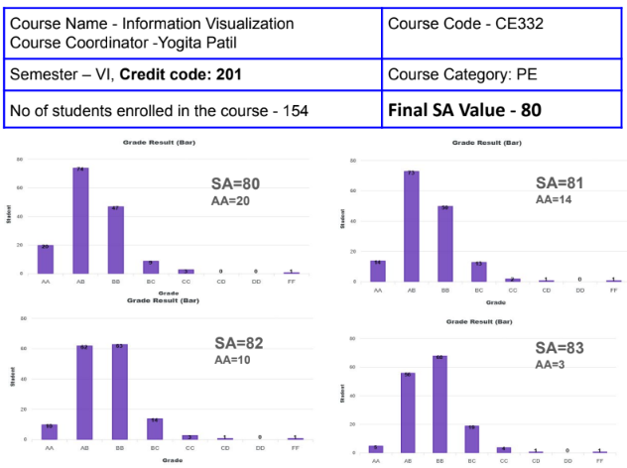
C4. Coverage of syllabus in examinations including ISE, MSE, ESE is fair, and MSE/ESE are designed to have natural gaussian. (PE)- AAG
SAMPLE Gaussian Distribution Graph for PE subjects

Slide 35
C5 Transparency in evaluation including display of marks/ grades secured in every course.
The ISE ,MSE , ESE dates and grading method along with Rubrics are announced at the start of the course through common platform like Google Classroom ,Email, Moodle ,e.t.c. to maintain transparency in evaluation system.Also , the marks are displayed immediately after the assessment.
Open house gets conducted for MSE/ESE
Grievances gets addressed in the open house

Slide 36
C6 Department encourages innovations in the assessment. Identifies the best performing faculty in this aspect. Rupali S.

Slide 37
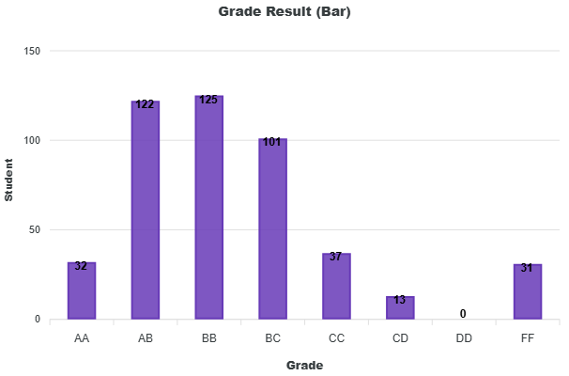
C7 Department analyzes the results critically, reason out the abnormalities, deliberates in meetings, and finds out the solutions. Extremities are identified and mentored. RK
Course Name - Operating System
No of students enrolled in the course - 451
Final SA Value - 73
Subject faculty prepares slides with 4 SA value graphs
Department meeting is convened to analyze SA value
Final SA value is selected such that %students in AA grade is 10-15% of total students

Slide 38
Usually SA Values are used for relative Grading and the result should follow the Gaussian Distribution
The OPEN house is conducted for MSE and ESE where students can see his/her paper and marks awarded
Any grievances raised are solved by rechecking of the questions
If students who are unable to clear the examination, re-exam is held after the results are declared

Slide 39
C8 Quality of assessment tools and extent of attainment of learning outcomes
Batch 2021-25
PO | PO 1 | PO 2 | PO 3 | PO 4 | PO 5 | PO 6 | PO 7 | PO 8 | PO 9 | PO 10 | PO 11 | PO 12 | PSO 1 | PSO 2
Target | 2.29 | 2.21 | 2.33 | 1.85 | 2.45 | 1.86 | 1.13 | 2.07 | 2.02 | 2.13 | 1.83 | 1.82 | 2.15 | 1.72
Direct | 1.75 | 1.76 | 1.73 | 1.67 | 1.90 | 1.49 | 1.35 | 1.22 | 1.59 | 1.69 | 1.79 | 1.49 | 1.39 | 1.16
Indirect | 2.40 | 2.48 | 2.37 | 2.22 | 2.41 | 1.76 | 1.06 | 2.23 | 2.33 | 2.58 | 2.37 | 2.44 | 1.87 | 2.26
Attainment | 1.88 | 1.91 | 1.86 | 1.78 | 2 | 1.54 | 1.29 | 1.42 | 1.74 | 1.87 | 1.9 | 1.68 | 1.49 | 1.38

Slide 40
C8 Quality of assessment tools and extent of attainment of learning outcomes
Batch 2022-26
PO | PO 1 | PO 2 | PO 3 | PO 4 | PO 5 | PO 6 | PO 7 | PO 8 | PO 9 | PO 10 | PO 11 | PO 12 | PSO 1 | PSO 2
Target | 2.39 | 2.14 | 2.19 | 1.74 | 2.29 | 2.20 | 1.40 | 2.36 | 2.25 | 2.10 | 1.83 | 1.93 | 2.00 | 1.80
Direct | 1.88 | 1.66 | 1.66 | 1.41 | 1.79 | 1.59 | 1.10 | 1.52 | 1.54 | 1.41 | 1.47 | 1.52 | 1.17 | 1.29
Indirect | 2.44 | 2.25 | 2.21 | 1.73 | 2.25 | 1.80 | 1.05 | 2.51 | 2.32 | 2.19 | 1.56 | 2.08 | 1.33 | 1.45
Attainment | 1.99 | 1.78 | 1.77 | 1.47 | 1.88 | 1.63 | 1.09 | 1.72 | 1.69 | 1.56 | 1.49 | 1.63 | 1.2 | 1.32

Slide 41
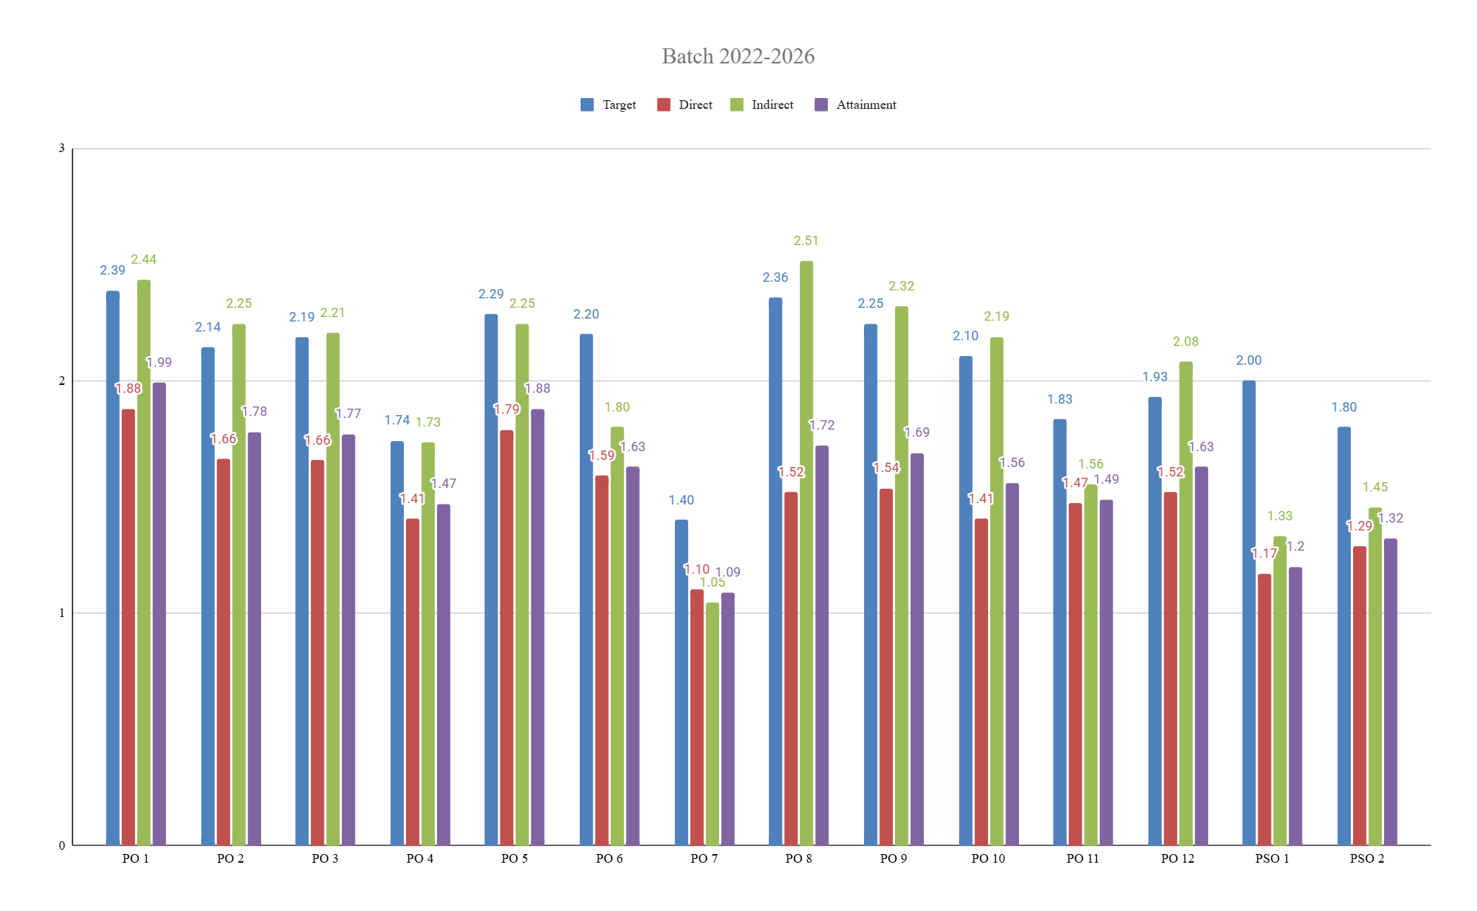
C9 Department checks the course attainment every semester, PO/PSO attainment every year, PEO attainment at an interval of 4 years. Falak M.

Slide 42
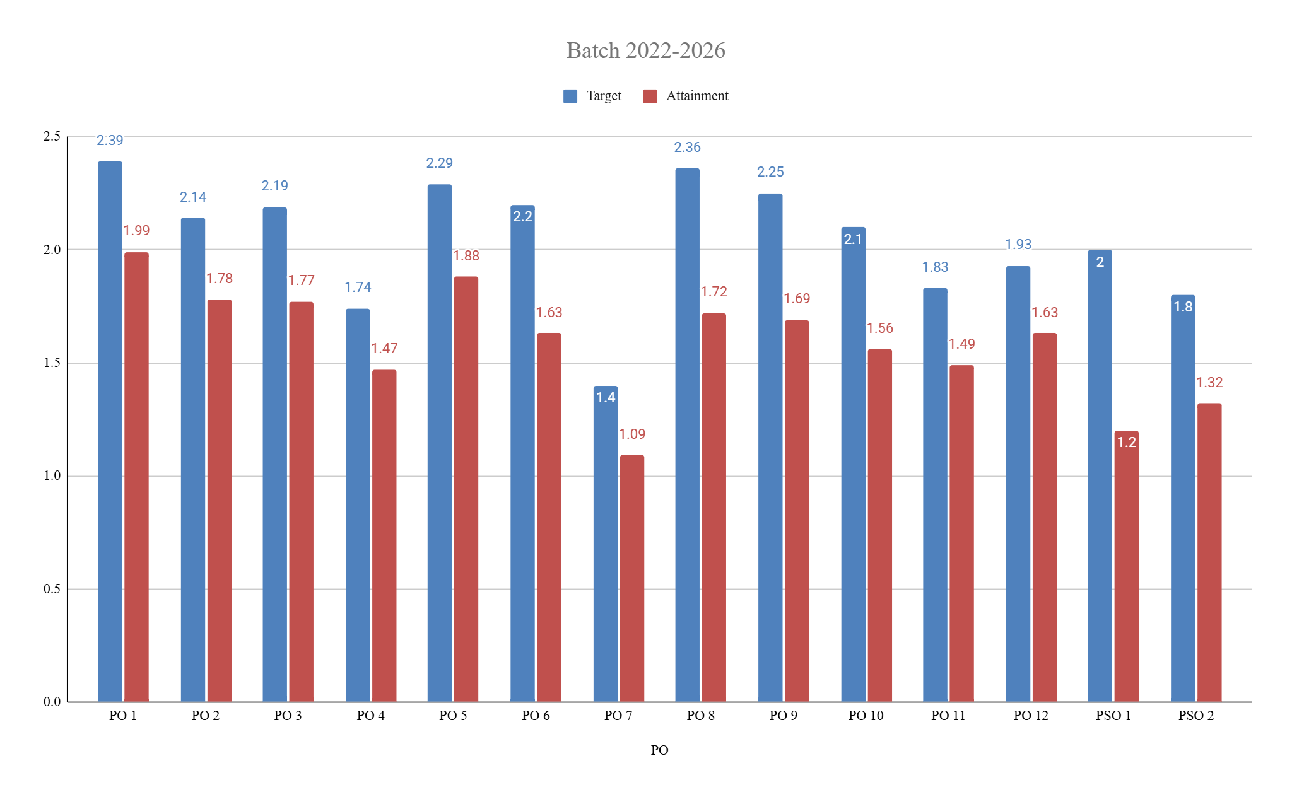
C9 Department checks the course attainment every semester, PO/PSO attainment every year, PEO attainment at an interval of 4 years. Falak M.

Slide 43
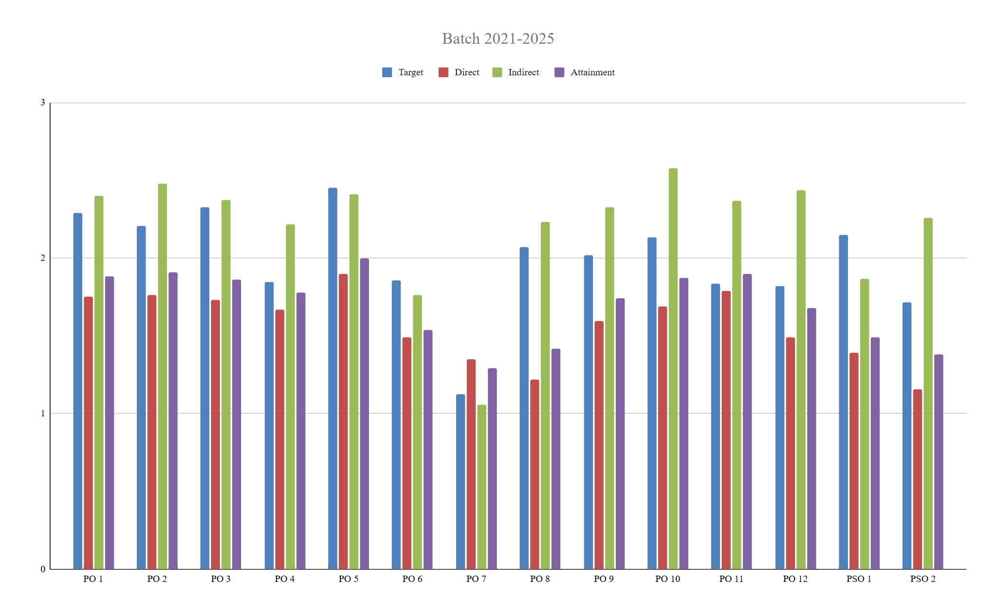
C9 Department checks the course attainment every semester, PO/PSO attainment every year, PEO attainment at an interval of 4 years. Falak M.

Slide 44
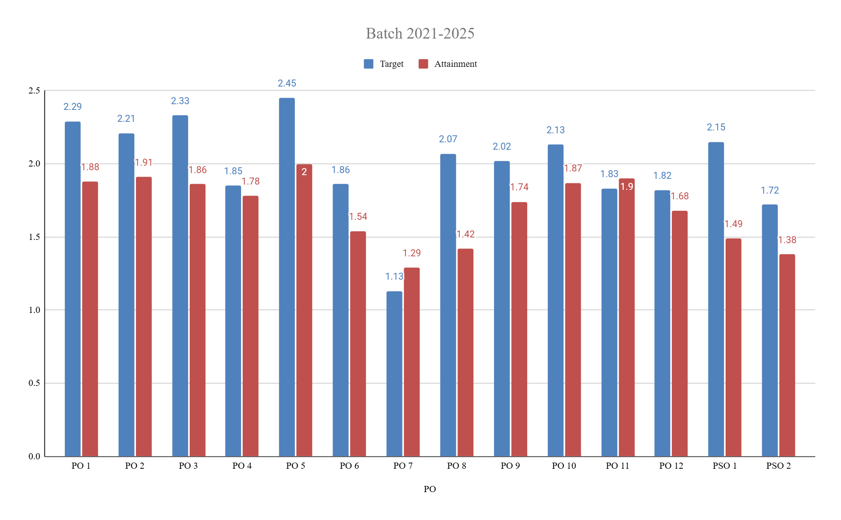
C9 Department checks the course attainment every semester, PO/PSO attainment every year, PEO attainment at an interval of 4 years. Falak M.

Slide 45
D. Research

Slide 46
D.Research
1.Teachers are encouraged to participate in the FDP, Workshop, STTP.
2. Every Faculty publishes paper in reputed Conference or Journal.
3. Department organizes workshop,FDP for upgradation.
4. Research related activities : Students are encouraged to be a part of
Technical Research Paper Competitions.
5. Students are encouraged to work on Research Based Mini Projects.

Slide 47
D.1. Research related activities of faculty. Writing proposals for sponsored research projects, research focused projects for UG/PG students, PhD program PJB

Slide 48
D.1. Research related activities of faculty. Writing proposals for sponsored research projects, research focused projects for UG/PG students, PhD program SBG

Slide 49
D.2. Industrial projects, Sponsored research, collaborations and consultancy PJB

Slide 50
D.2. Industrial projects, Sponsored research, collaborations and consultancy AVN

Slide 51
D.3. Faculty publications, quality, citations, h-index, and IPR, books and book chapters, monograms. JS
Year | Journals | Conference | Book Chapters | Patents
2025-26 | 20 | 25 | 5 | 2
2024-25 | 13 | 25 | 2 | 5
Year | Scopus Indexed Journals | SCI/ESCI
2025-26 | 09 | 04
2024-25 | 03 | 01
Citations
2024 | 2025 | 2026
1168 | 1077 | 294+

Slide 52
D.4. Faculty achievements, awards and recognition JS
Name of Faculty | Achievement
Prof. Anand Godbole | NPTEL Discipline Star Award
Dr. Pramod Bide | Best Innovative Teaching Award by L&T Edutech
Dr. Jignesh Sisodia | Best Software Project Award by Cantilever
Prof. Govind Gaundalkar | Best Question Paper Award, for the subject Digital Systems
Dr. Jignesh Sisodia, Prof. Abhijit Salunke | Best Question Paper Award, for the subject Computer Communication and Networks

Slide 53
D.5.Student publications and IPR YP

Slide 54
D.6. Student participation and success in the technical competitions of repute, AICTE hackathon, ROBOCON, etc.
Competition Category | Distinct Events | Student Entries
Hackathon | 20 | 50
Case Study Competition | 13 | 23
Technical / Examination | 5 | 9
Competition / Recognition | 7 | 9
Event Coordination | 2 | 6

Slide 55
D.5.Student publications and IPR YP

Slide 56
E. STUDENT SUPPORT & PROGRESSION

Slide 57
E.1.Department has well planned mentorship scheme and every student is reached. There is observed periodicity. The problems/concerns are immediately addressed, and this process is well documented. YP

Slide 58
E.2.Department has effective mechanisms for academic monitoring both formally and informally. The feedback, suggestions are considered duly. SBG
The department regularly monitors academic activities through formal and informal mechanisms.
Feedback and suggestions from students and faculty are reviewed and considered for improvement.
Class Representatives (CRs) help in identifying and communicating academic issues and concerns.

Slide 59
E.3.Department has a 360-degree feedback system, student feedback on academics, admin etc, grievances/ redressal and its effectiveness AVN

Slide 60
E.4.Department maintains close relations with the alumni and derives best possible benefits with their association. For example, co teaching, special lectures, co supervision of projects etc. JR

Slide 61
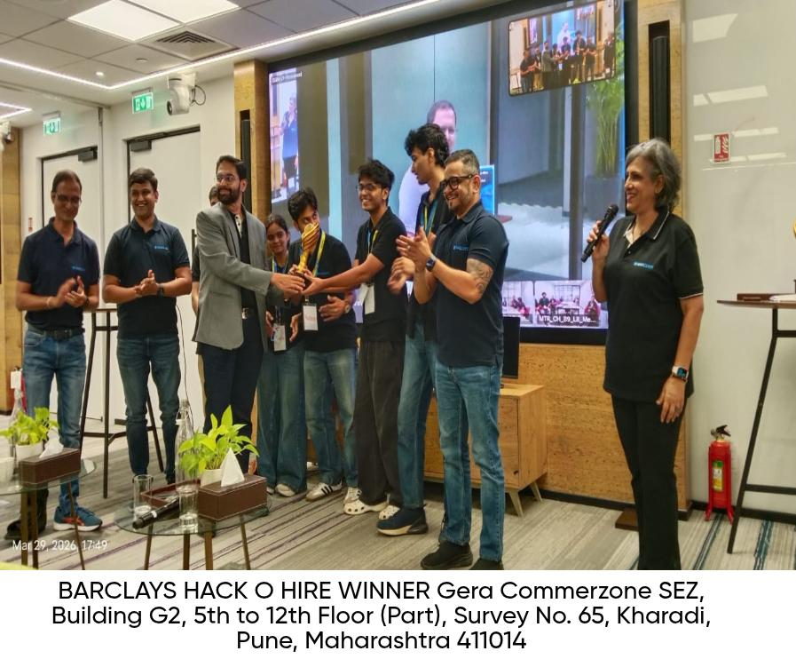
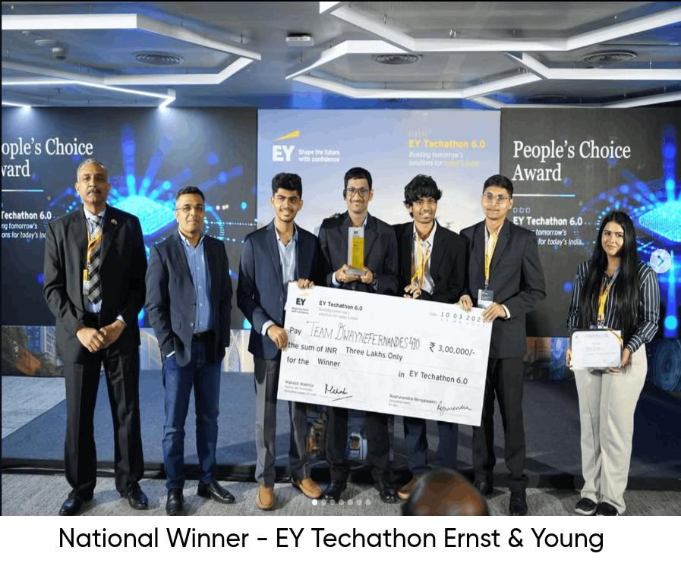
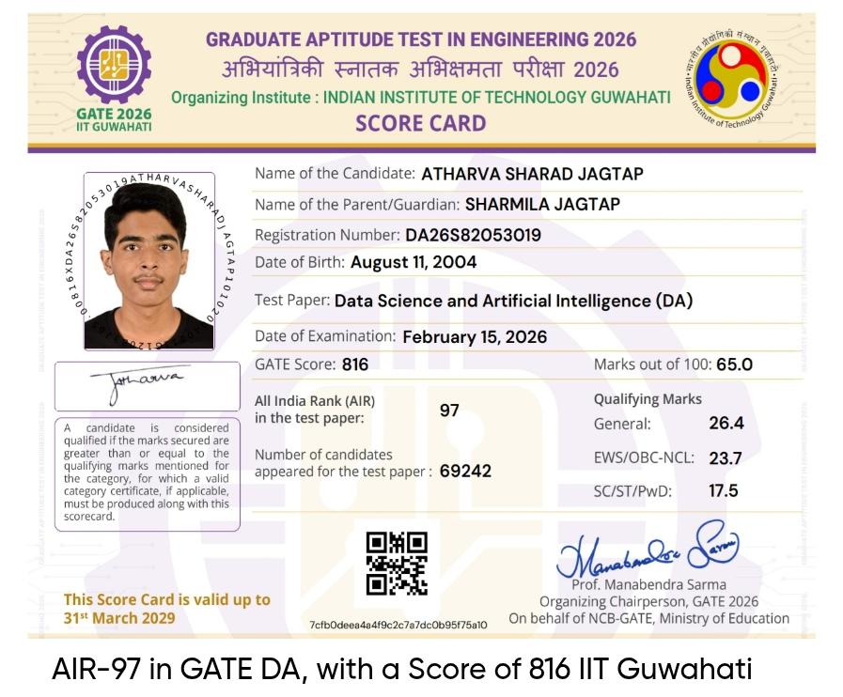
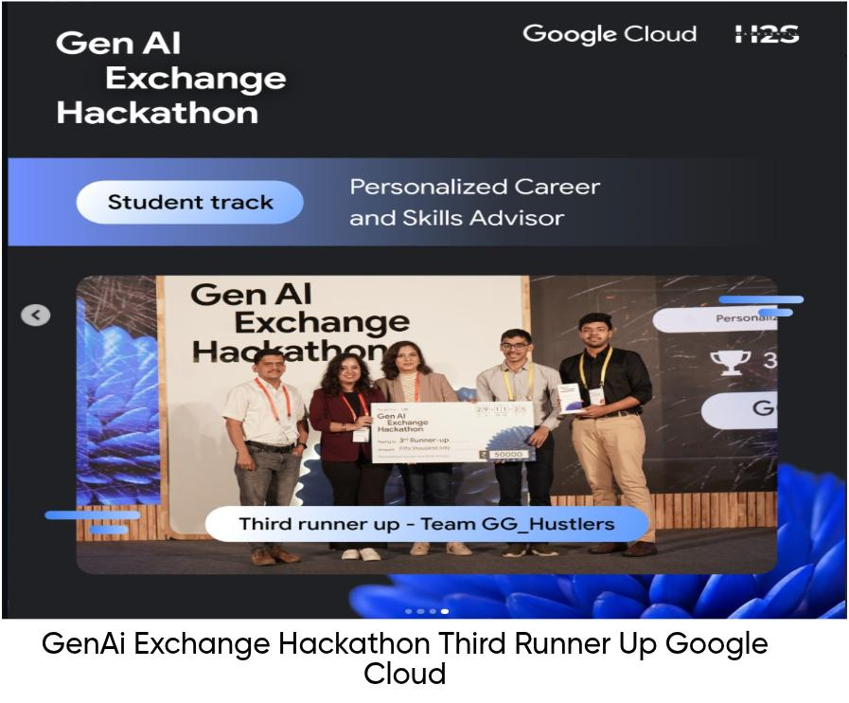
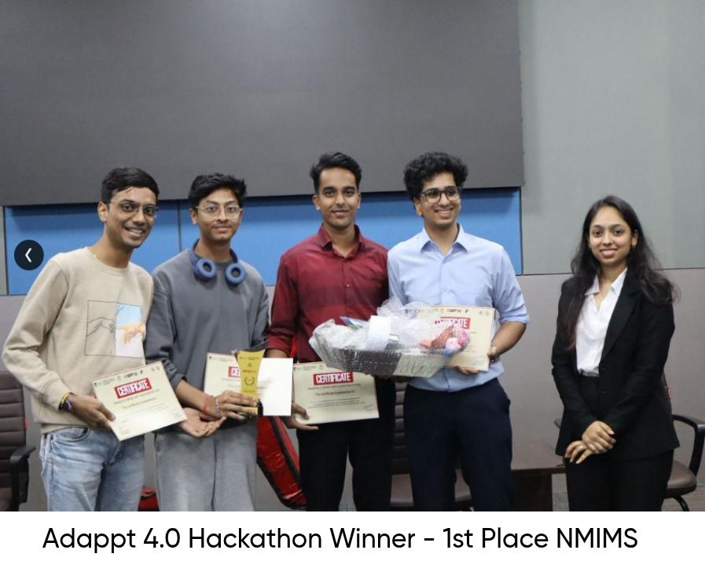
E.5.Students’ participation in extracurricular and cocurricular activities, technical and cultural events, quizzes, workshops, seminars, conferences, exhibitions, tech competitions like ROBOCON, BAHA etc.

Slide 62
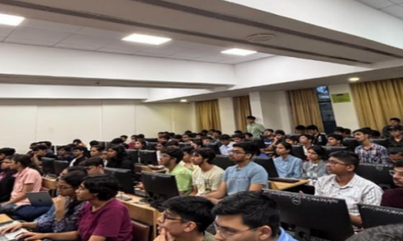
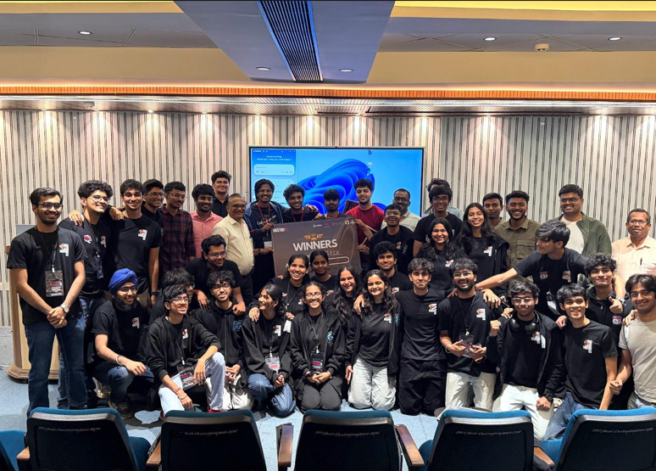
E.6.Institute promotes the culture of student clubs. Students are motivated and encouraged to start dedicated, focused student clubs with diversified objectives.-
Computer Society of India(CSI) conducted various activities and workshops for students such as Git and GitHub Workshop ,Code Housie ,SomETHing Decentralised ,Pixel Perfect ,Code it Ralph ,ML Sprint ,Design Disaster ,UnSQLved ,SPIT Hackathon and SE Hackathon etc
SPIT Hackathon
GitHub session

Slide 63
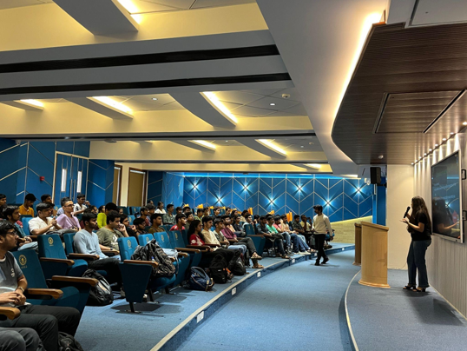
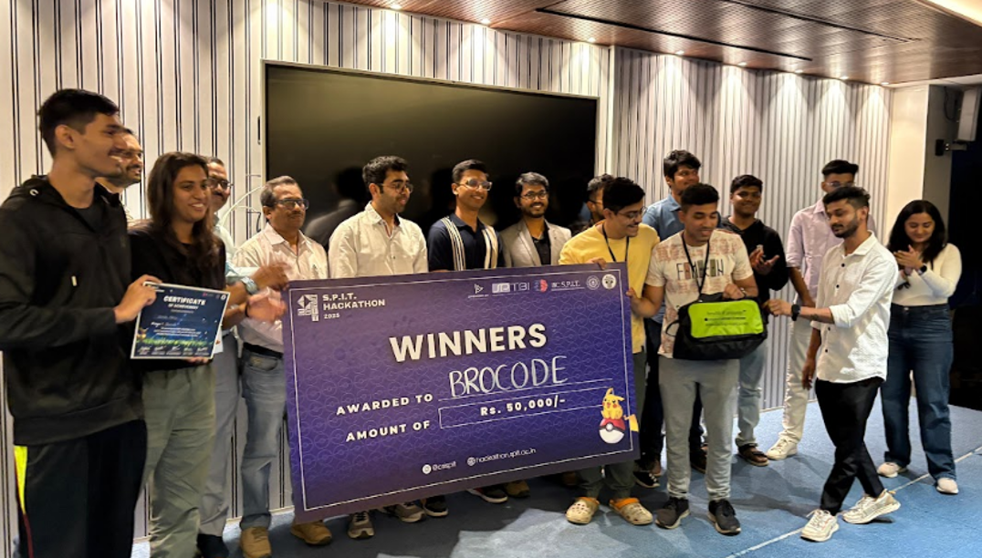
GSoC session 2024-2025
SPIT Hackathon 2024-2025

Slide 66
CSI EVENTS 2024-25 CSI KKD
E.6.Institute promotes the culture of student clubs. Students are motivated and encouraged to start dedicated, focused student clubs with diversified objectives.-
Name of Event | Date
Tech Roadmap | 30th September 2024
GSoC Session | 1st October 2024
Git GitHub Session | 1st October 2024
Source Start | 1st - 31st October 2024
CodeHousie | 17th October 2024
Name of Event | Date
rAPId | 5th February 2025
UnSQLved | 6th February 2025
Main Speaker Session | 7th February 2025
S.P.I.T Hackathon | 8th-9th February 2025
Code Uncode | 20th February 2025
SE Hackathon | 19th-20th April 2025
Minithon | 20th October 2024
Mini Source Start | 23rd October 2024
Frontend Odyssey | 1st February 2025
SQL and API Workshop | 4th February 2025

Slide 67
GSoC session 2024-2025
SPIT Hackathon 2024-2025

Slide 68
CSI Events 2025-2026
Name of Event | Date
Git and GitHub Workshop | 1st October 2025
Code Housie | 16th October 2025
SomETHing Decentralised | 3rd November 2025
Pixel Perfect | 14th February 2026
Code it Ralph | 16th February 2026
Name of Event | Date
ML Sprint | 17th February 2026
CTRL Fix+ Takedown | 18th February 2026
Design Disaster | 19th February 2026
UnSQLved | 20th February 2026
SPIT Hackathon | 21st February 2026
SE Hackathon | 18th April 2026

Slide 69
Computer Society of India(CSI) Year 2025-2026 conducted various activities and workshops for students such as Git and GitHub Workshop ,Code Housie ,SomETHing Decentralised ,Pixel Perfect ,Code it Ralph ,ML Sprint ,Design Disaster ,UnSQLved ,SPIT Hackathon and SE Hackathon etc
SPIT Hackathon
GitHub session

Slide 70
E.6.Institute promotes the culture of student clubs. Students are motivated and encouraged to start dedicated, focused student clubs with diversified objectives.- PJB (IEEE)

Slide 71
E.6.Institute promotes the culture of student clubs. Students are motivated and encouraged to start dedicated, focused student clubs with diversified objectives.- SRD (FACE)

Slide 72
E.6.Institute promotes the culture of student clubs. Students are motivated and encouraged to start dedicated, focused student clubs with diversified objectives.- KKD (CSI)

Slide 73
E.7.Student achievements, awards and recognitions. JS

Slide 74

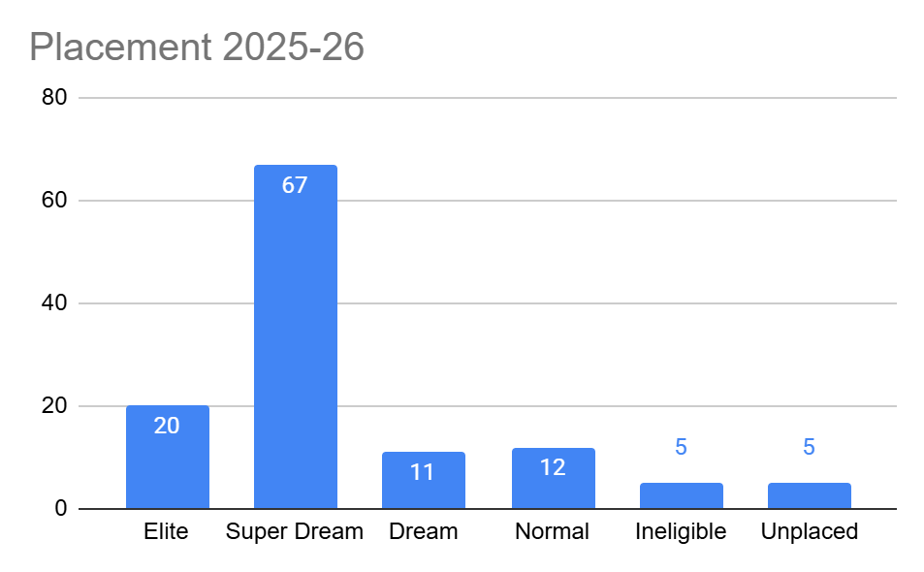
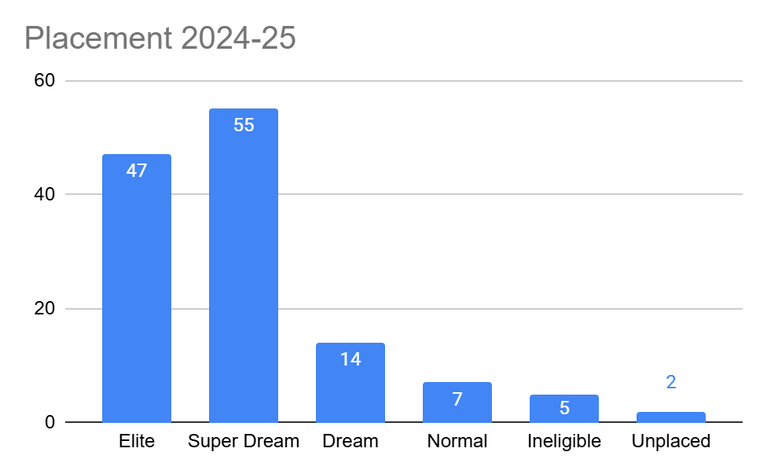
E.8. Student competency in terms of placements in reputed industries. Percentage placement, average salary, median salary of the graduating batch of the program SK

Slide 75
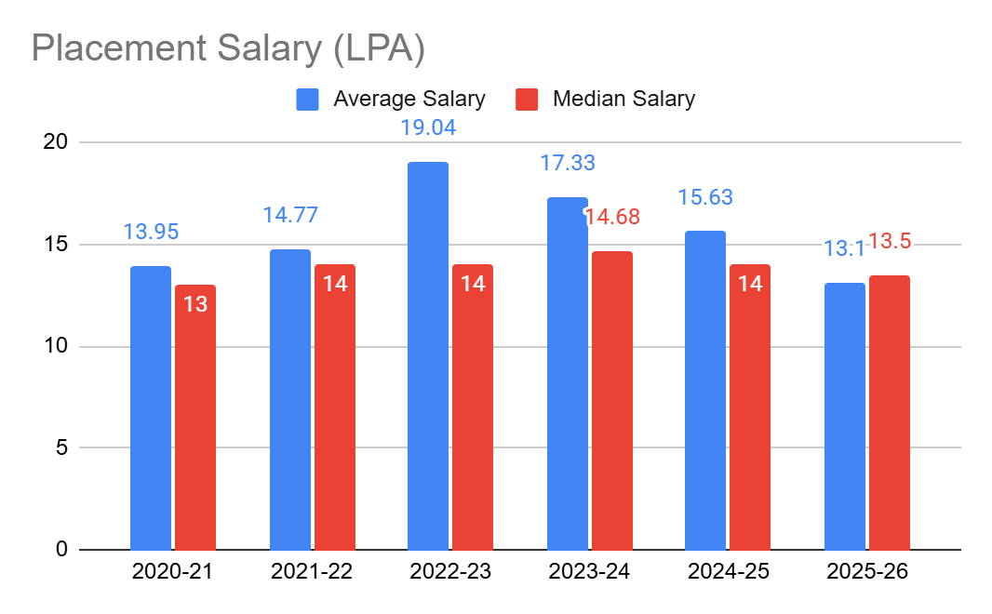
Highest, Average and Median salary
 | 2020-21 | 2021-22 | 2022-23 | 2023-24 | 2024-25 | 2025-26
Highest Salary | 42 | 30.5 | 110 | 50 | 50 | 33
Average Salary | 13.95 | 14.77 | 19.04 | 17.33 | 15.63 | 13.1
Median Salary | 13 | 14 | 14 | 14.68 | 14 | 13.5
Lowest Salary | 4 | 6.3 | 5 | 3 | 3.5 | 3

Slide 76
E.9. Department takes significant efforts to fetch industry sponsorship for UG/PG projects and ensures the quality execution of these projects. SBG
The department encourages students to take up research internships and project work with reputed organizations such as IITs, ISRO, BARC, and NTRO.
These opportunities give students valuable practical exposure and help them gain experience in working on real-world problems.

Slide 77
F. ADMINISTRATION

Slide 78
F.1. Department has well thought Vision-Mission and has carefully articulated Program Education Objectives and Program specific objectives for all the programs run by the department. Rupali S.

Slide 79
F.2. Department has a strategic plan which is broadly in line with the institute’s strategic plan. PBB

Slide 80
F.3. Department has a documented manual for all processes, procedures and information is disseminated to all stakeholders. Transparency is maintained to the best possible level. AVN

Slide 81
F.4. Grievances are duly addressed for students, faculty, and staff. PBB

Slide 82
F.5. Department meets the target set by the institute. PBB

Slide 83
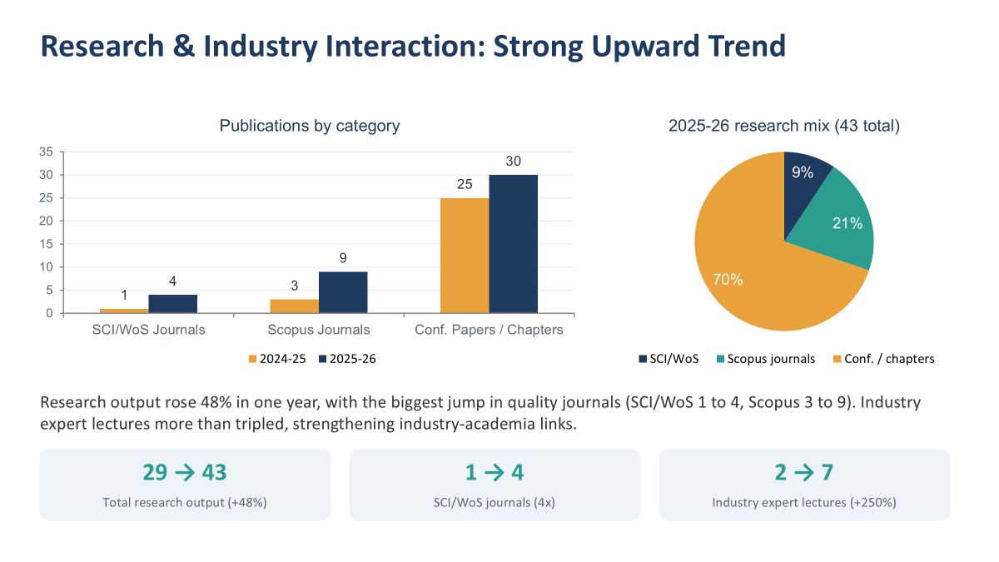
F.5. Department meets the target set by the institute. PBB

Slide 84
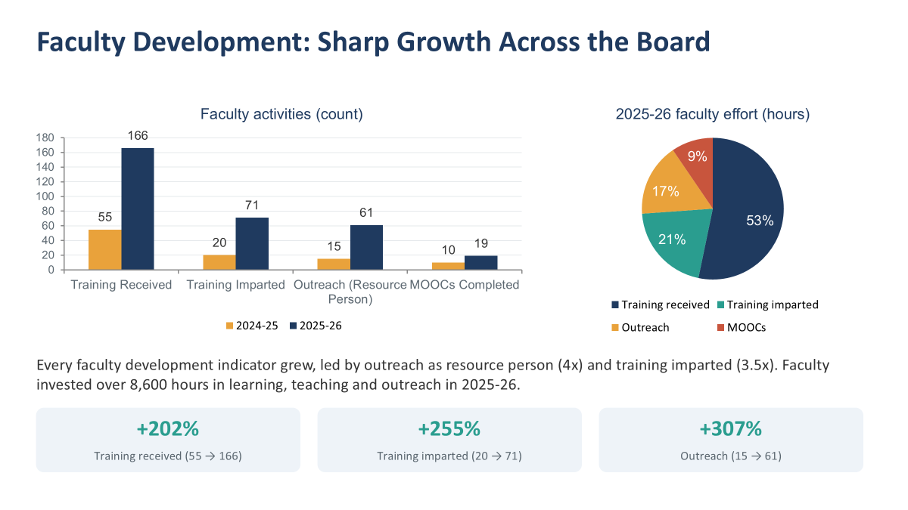

Slide 85
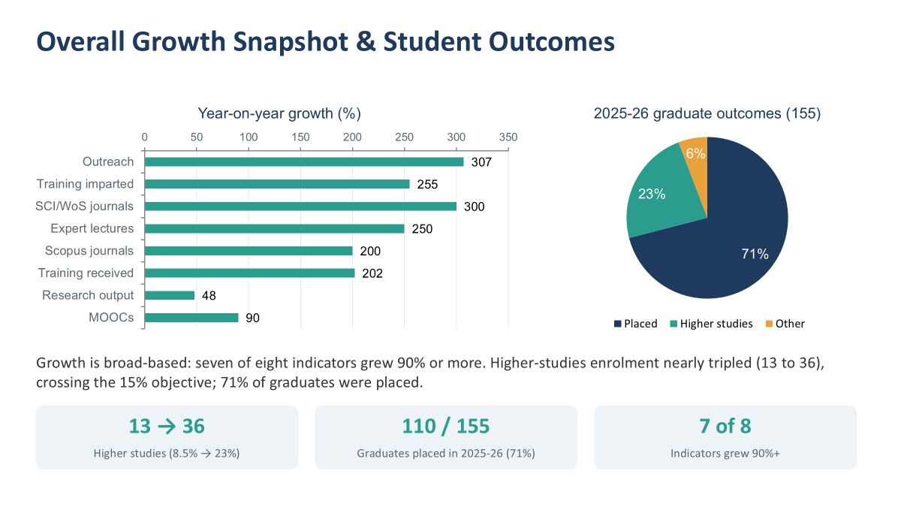

Slide 86
F.6. Department values continuous learning, value addition and takes sincere efforts in that direction. RK

Slide 87
F.7.Department ensures that the inputs/feedback received from various procedures (internal and external audits, accreditation visits, QP analysis) are analyzed, discussed, deliberated, and implemented to the best possible level as a part of continuous improvement. PBB

Slide 88
F.7.Department ensures that the inputs/feedback received from various procedures (internal and external audits, accreditation visits, QP analysis) are analyzed, discussed, deliberated, and implemented to the best possible level as a part of continuous improvement. AAG
The process of audit of Question paper is carried out by the examination section. and then feedback is given to concerned teacher of the subject. H.O.D formally gives instruction to concerned teacher to improve upon the drawn question paper. Faculty is asked to update the question paper and asked to follow the guidelines of Bloom's taxonomy , CO-PO mapping.

Slide 89
CRITERIA G -
SWOC Analysis

Slide 90
Goals of the Departments

Slide 91
Strengths

Slide 92
Thank You!

